Slide 1
Architecture documentation (part 1)
Yauhen Baranouski
May 2023
CONFIDENTIAL | © 2023 EPAM Systems, Inc.

Slide 2
Agenda
what and why – documentation and stakeholders
how – the rules of sound documentation
documentation kinds and notations
proven documentation tools
best practices for graphical notations
CONFIDENTIAL | © 2019 EPAM Systems, Inc.

Slide 3
What and why – documentation and stakeholders
Notes:
What is documentation for you?

Slide 4

What and why – documentation and stakeholders
Architecture documentation
is anything that captures the architecture outside its author’s mind

Slide 5

What and why – documentation and stakeholders
Stakeholder
is anyone interested in the product being developed
wants to understand the product from his/her point of view at any time
for planning
for budget allocation
for implementation
for testing
etc

Slide 6
What and why – documentation and stakeholders
architecture AUTHORS vs others
the author also may forget the details over the time
constantly asking the author about the details is ineffective in any case
so, at least key decisions must be documented all the time
ALSO, architecture is important for
onboarding new members
tracking decision history and lessons learned
showing progress even when implementation hasn’t started
simplifying mind context switching when dealing with many activities
building a common communication language
automated validation and code generation

Slide 7
rules of sound documentation
Notes:
What is quality documentation for you?

Slide 8
Rules of sound documentation
Documentation makes sense if
Project expenses without docs – Project expenses with docs > Docs cost
documentation
should be built primarily for you
should not be an official report, but rather a diary
should be built continuously
write down every thought and every useful link
then, think on the desired TOC
then, organize the thoughts/links according to the TOC
then, polish using the 6 simple rules of sound documentation
CONFIDENTIAL | © 2019 EPAM Systems, Inc.

Slide 9

Rules of sound documentation
RULE 1 – make it clear, know your readers
follow their mind flow
stick to conventional terminology
create a glossary if necessary
just like with code, split documents based on
concerns
levels of abstractions
introduce table of contents and/or index documents for navigability

Slide 10

Rules of sound documentation
rule 2 – avoid unnecessary repetition
duplicates are hard to maintain
even paraphrasing may cause confusion
hyperlinks may help

Slide 11

Rules of sound documentation
rule 3 – avoid ambiguity
explain what knowledge is required to read the document
stick to the same notation for similar diagrams
mark incomplete sections as “TODO” or “TBD”
mark irrelevant sections as “N/A” instead of leaving them blank

Slide 12

Rules of sound documentation
rule 4 – stick to standards, use templates
prefer organization-wide templates
or develop team-scoped templates
or use personal templates
any template reduces the risk of missing something

Slide 13

Rules of sound documentation
rule 5 – track history
record rationale and, ideally, a change log
this helps avoiding past mistakes and useless work

Slide 14

Rules of sound documentation
rule 6 – keep it up to date
update periodically, but not fanatically
irrelevant documentation has no value
too frequent updates overweigh value
at least mark what’s outdated to save reader’s time
stick to project lifecycle – update per feature, release, etc
encourage feedback from readers – leave some contacts

Slide 15
Documentation kinds and notations
Notes:
What notations do you use on your projects? Or for your personal use? Why? What are your docs purpose?

Slide 16
Documentation kinds and notations
documentation formality
determines the level of ambiguity
influences automation abilities (e.g. code generation)
notations may be
informal – mind maps, box-n-line diagrams, free-form text
semi-formal – unified modeling language (UML), entity-relationship
formal – UML + metadata, architecture analysis-n-design language (AADL)

Slide 17
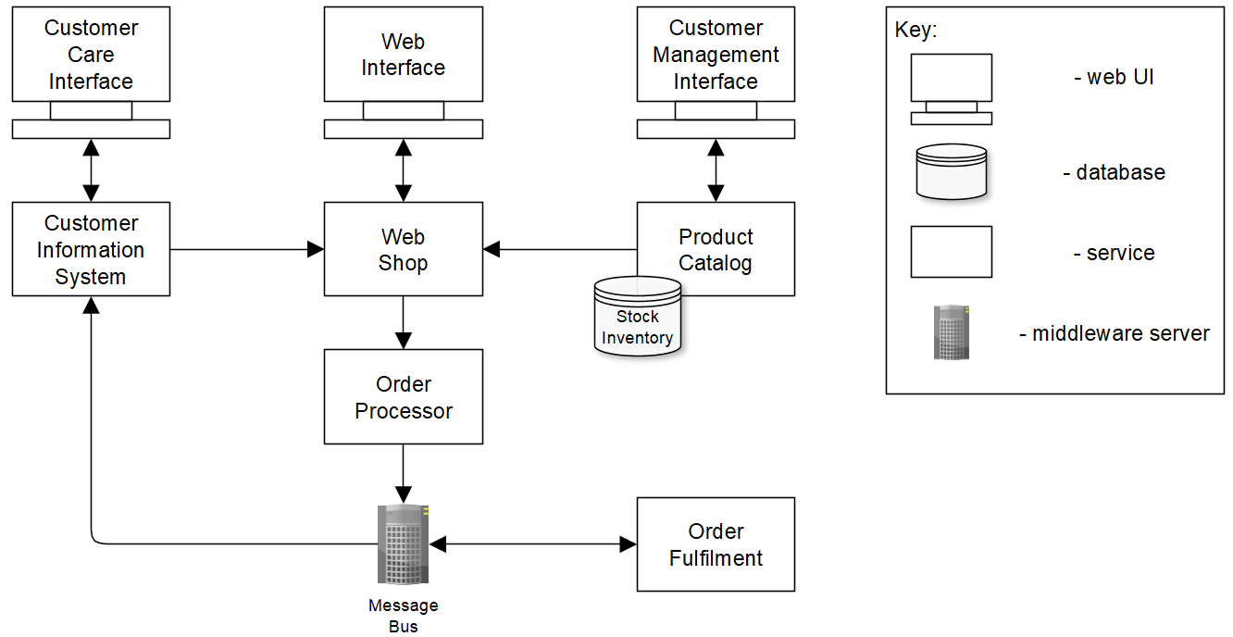
Documentation kinds and notations
line-n-box, aka box-n-lines,
aka box-n-arrows
+ simple to use and extend
+ friendly to non-technical readers
- is ambiguous without a detailed key
- poorly scales for complex cases
usages
simple data/process/component models
non-software documentation (like team organization charts)

Slide 18
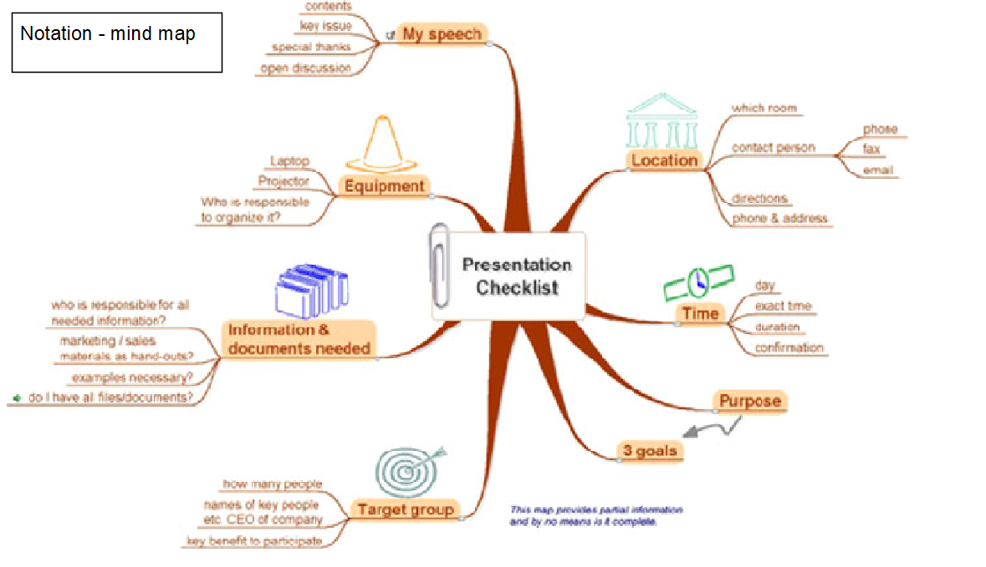
Documentation kinds and notations
mind maps
+ aids thinking and memorization
+ easy to master and understand
- poorly scales for complex cases
usages
brainstorming
lecture/meeting quick notes
pre-sales presentations

Slide 19
Documentation kinds and notations
cloud architecture diagrams
+ friendly to cloud-familiar readers
+ rich toolkit support
+ memorizable icons
- no strict drawing rules
- no support for low-level details
usages
high-level cloud design
pre-sales/case studies
infrastructure cost estimation
deployment planning

Slide 20
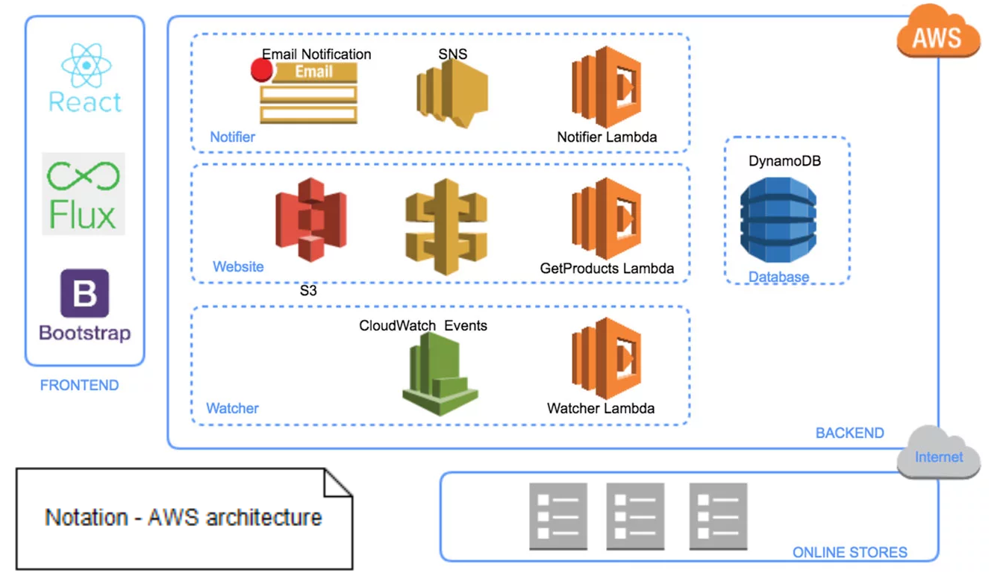
Documentation kinds and notations
cloud architecture diagrams - AWS
icon set
drawing guide

Slide 21
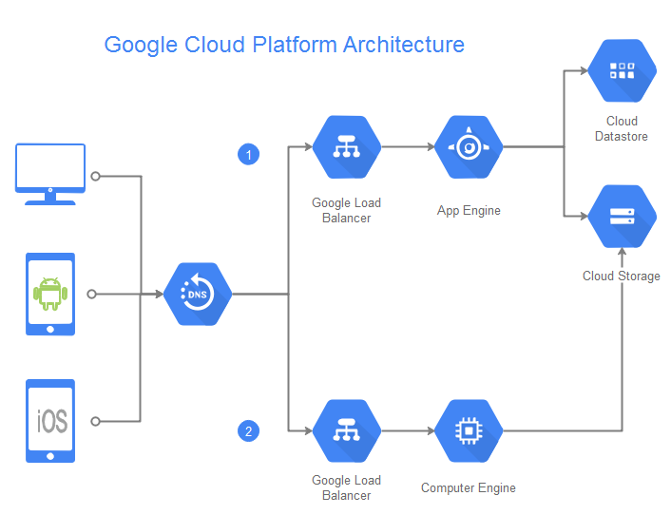
Documentation kinds and notations
cloud architecture diagrams – google cloud platform
icon set
drawing guide

Slide 22
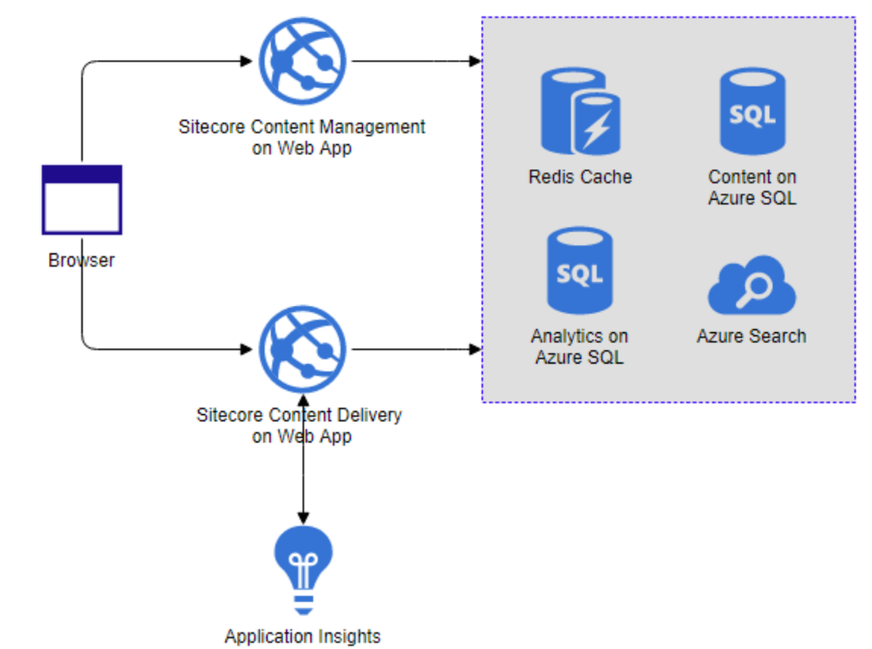
Documentation kinds and notations
cloud architecture diagrams – MicroSoft AZURE
icon set
drawing examples

Slide 23
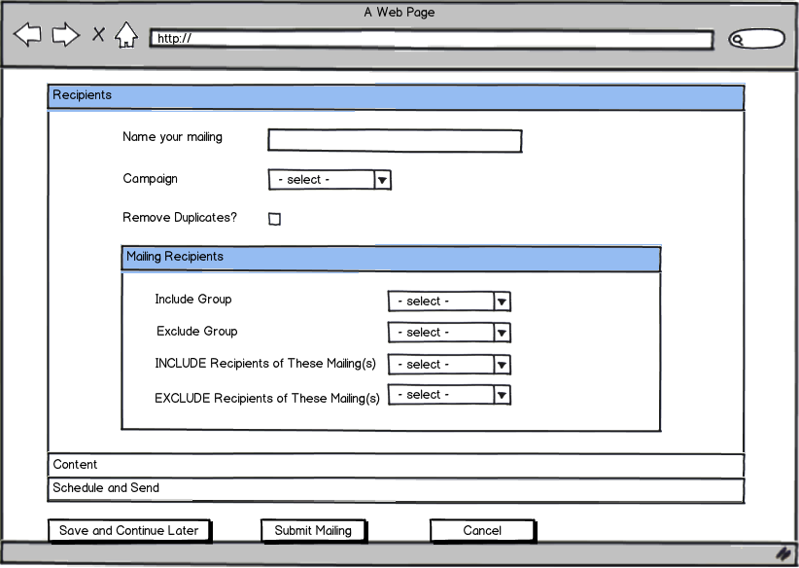
Documentation kinds and notations
mockups
+ perfect for UX discussions
+ may be as simple as line-n-boxes
- requires end user understanding
- requires some UX skills
usages
synchronize UX and functional requirements
communicate with designers and UX folks
sketching during customer discussions

Slide 24
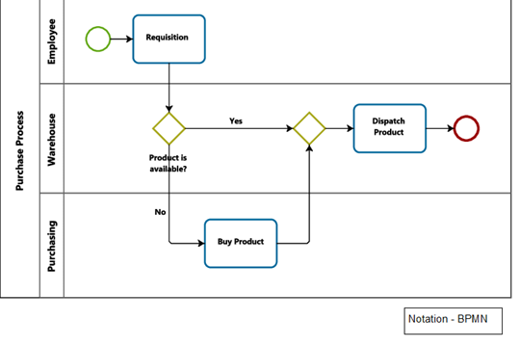
Documentation kinds and notations
business process
model and notation (BPMN)
+ friendly to business folks
+ quite simple yet expressive
+ supports extensions
+ friendly for automation tasks
- no support for non-behaviour models
- bloats with low-level details
usages
algorithm/process high-level design
communication with business experts
integration and deployment planning
as a definition language in workflow engines like jBPM or Activity (both open-source)

Slide 25
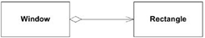

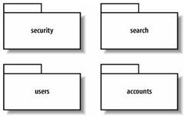
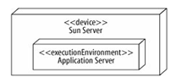
Documentation kinds and notations
Uml – logical view
Uml – process view
Uml – development view
Uml – physical view

Slide 26
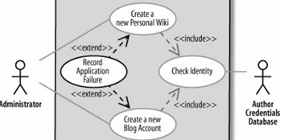
Documentation kinds and notations
Uml – use case view

Slide 27
Documentation kinds and notations
UML
+ may be formal or informal
+ rich notation and support for complex cases
+ rich tool support
+ code generation support
- too complex for the simplest cases
- hard to learn using the right diagram in right cases
- class/object diagrams poorly scale for large data models
USages
basically any design which covers more than 2 weeks of implementation

Slide 28
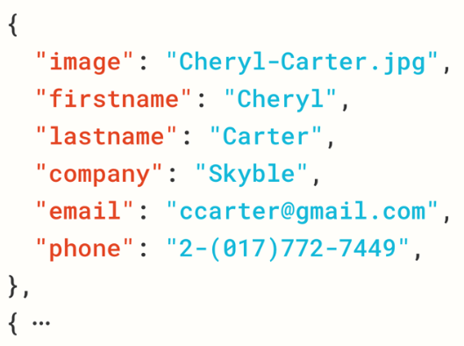
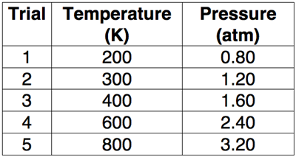
Documentation kinds and notations
Data modeling – data samples
tables
JSON/YAML/XML documents
text blobs
CSVs
useful for
initial business analysis
documenting algorithm’s inputs/outputs
documenting REST, SOAP, and other APIs

Slide 29
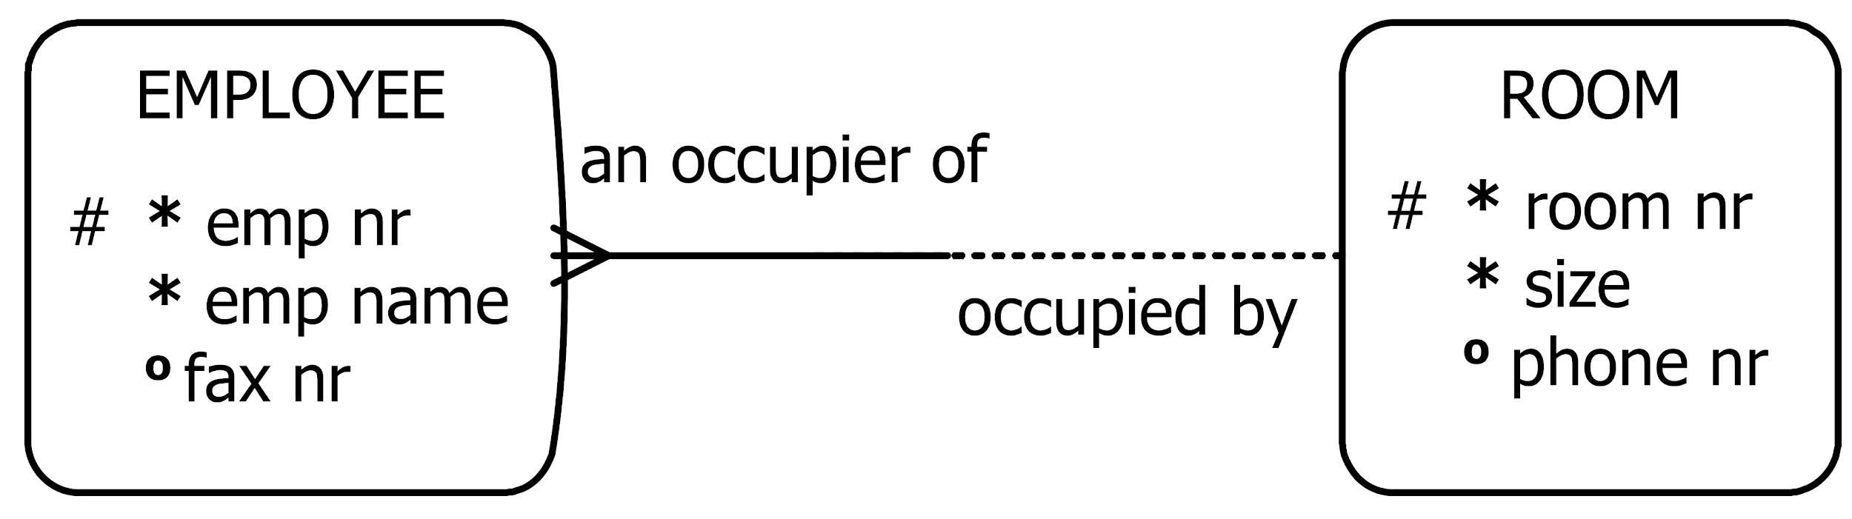
Documentation kinds and notations
data modeling – entity-relationship
+ is close to runtime data structures
+ is quite robust
- unstable in the presence of schema changes
- requires some technical background
USages
logical data modeling during API design
physical data modeling during database design/optimization design

Slide 30
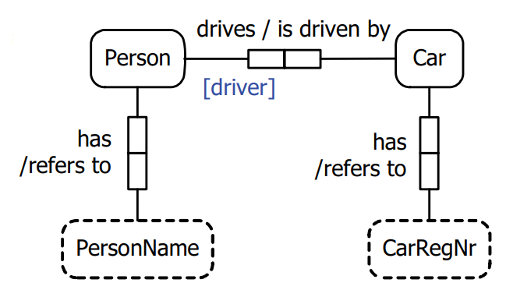
Documentation kinds and notations
data modeling – object-role
+ supports verbalization
+ allows validation against sample data
+ is resistant to frequent requirement changes
+ scales decently
- requires a different mind set
USages
conceptual modeling during early solution design

Slide 31
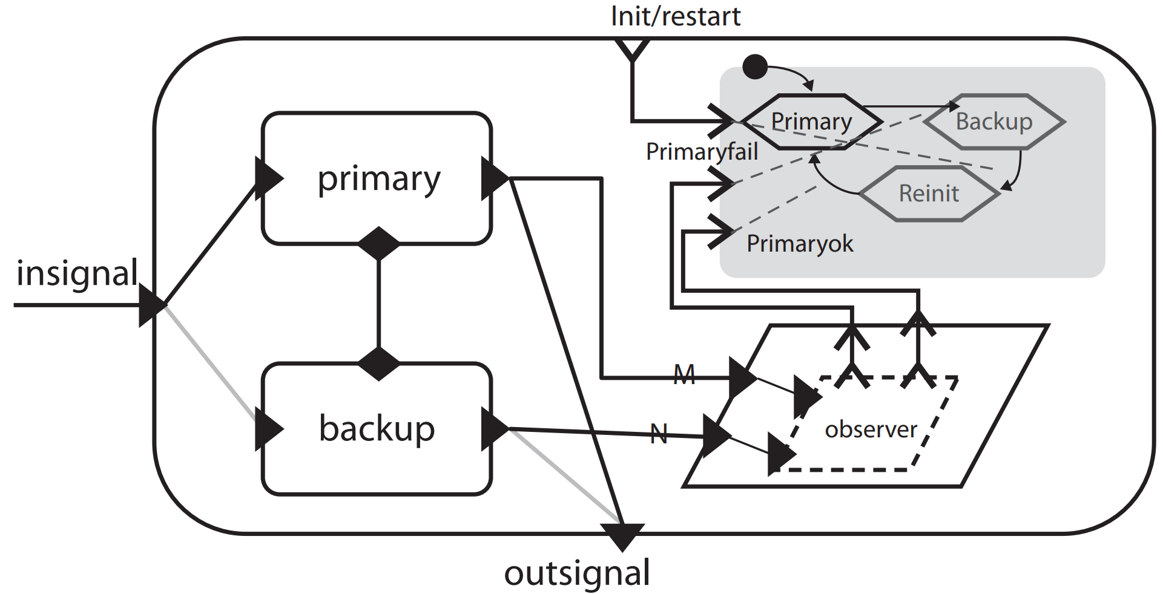
Documentation kinds and notations
formal notations - aadl
+ has both text and graphical forms
+ is friendly for automation
- very low-level and specific
USages
design of critical industry-specific solutions
avionics, aerospace, automotive, medical devices

Slide 32
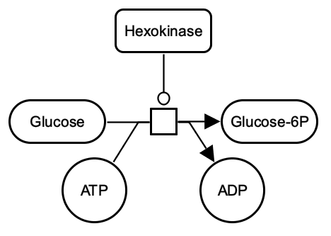
Documentation kinds and notations
domain-specific notations
+ highly optimized for very specific business
- cannot be used outside the target domain
example – systems biology graphical notation (SBGN)
used for modeling biological processes

Slide 33
Documentation tools
Notes:
What tools do you use projectly or personally?

Slide 34
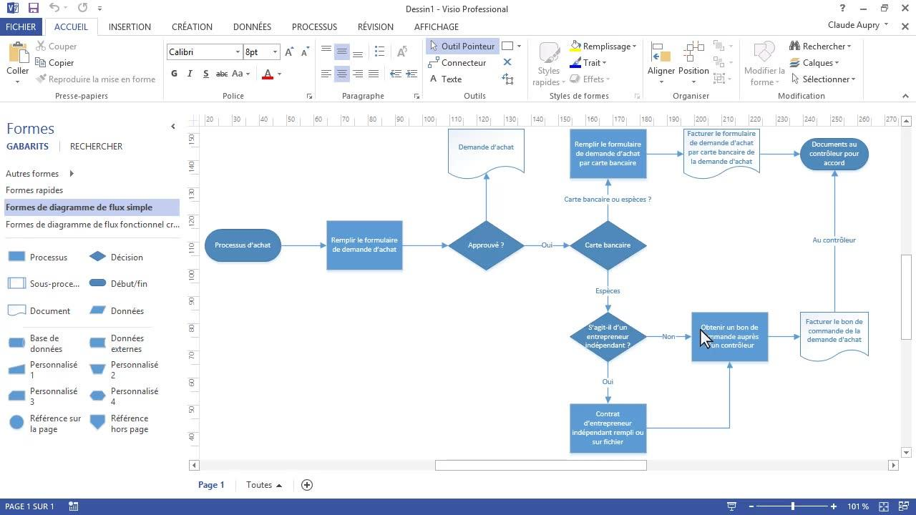
Documentation tools - offline
ms visio – mature and epam-approved
+ support of many notations
+ semi-formal and informal
+ integration with MS Office
+ EPAM-approved
+ VSDX file format is widely supported by other tools
- commercial

Slide 35
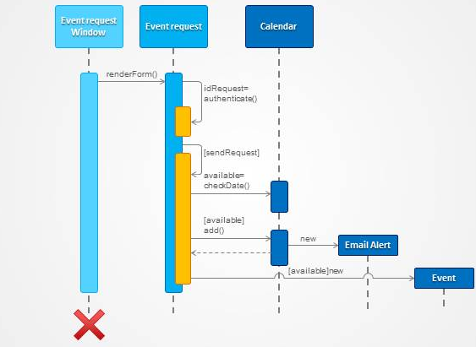
Documentation tools - offline
power point – best for mixed content
+ powerful vector graphics
+ text & images & animations = full documentation kit
+ presentations with frequently used notation elements and even document templates may be re-used
- Open-Office features might differ from MS Office

Slide 36
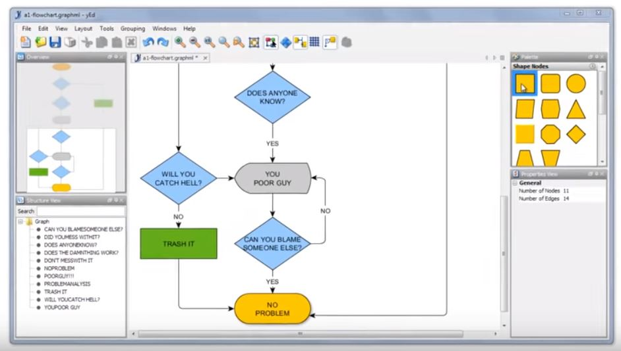
Documentation tools - offline
yed from yworks – best free simplistic quickstarter tool
+ free
+ easy to use
+ cross-platform
+ many notations out-of-box
+ non-strict/mix-n-match
+ support for UML, BPMN, ER, flowcharts, arbitrary graphs

Slide 37
Documentation tools - offline
yed from yworks – best free simplistic quickstarter tool
stutters for large diagrams
only image export
no VSDX import
builds with latest JDK may break
DOWNLOAD here
https://www.yworks.com/products/yed

Slide 38
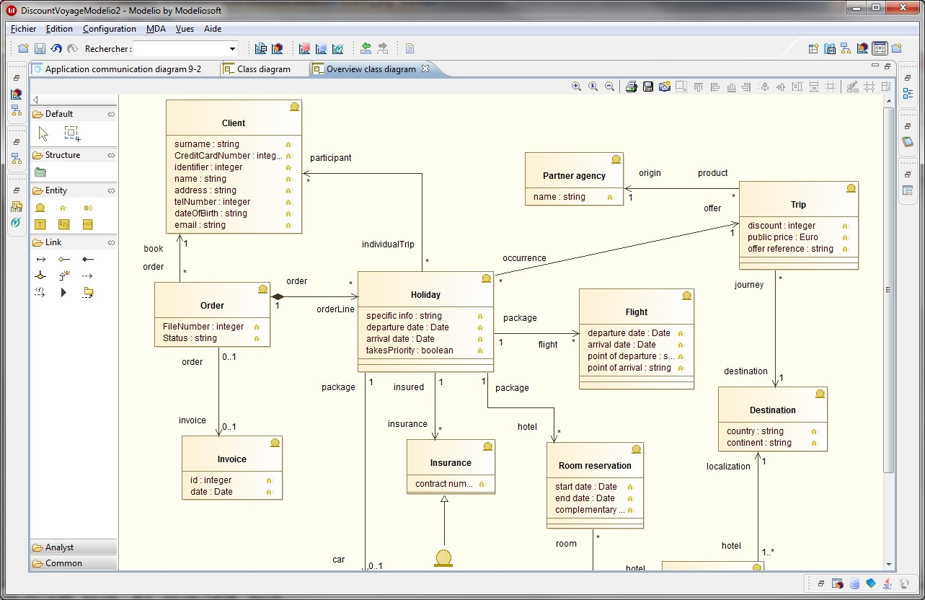
Documentation tools - offline
modelio – advanced solution with automation support
+ open-source & Eclipse-based
+ groups diagrams into projects with a rich metamodel
+ plugins/scripting support
+ free drawing and DOCX comments

Slide 39
Documentation tools - desktop
modelio – advanced solution with automation support
quite complex
non-trivial to learn
- may have bugs
download here
https://www.modelio.org/downloads/download-modelio.html

Slide 40
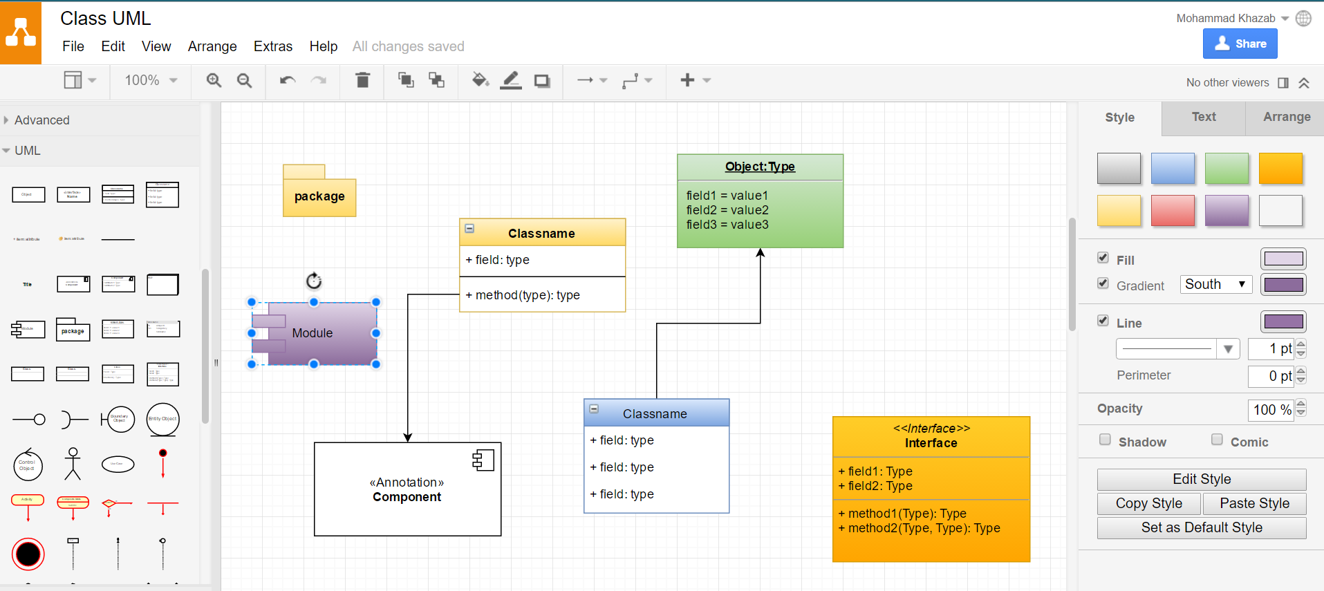
Documentation tools - online
DRAW io – best free general-purpose solution
+ free
+ easy to use
+ no strict drawing rules
+ can export to local drive, OneDrive, or Google Drive
+ can import VSDX
+ continuously improves

Slide 41
Documentation tools - online
commercial solutions – may be used by customers
LucidChart
Gliffy
Visio online
JIRA cloud and confluence plugins – paid add-ins
Draw IO (that’s where they get money!)
LucidChart
Gliffy (Confluence only)
google docs plugins
Gliffy (free)

Slide 42
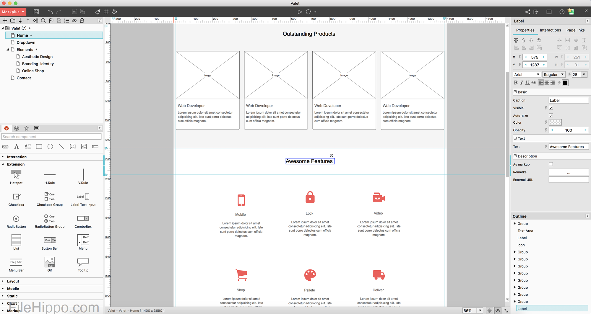
Documentation tools - mockups
mockups
may be done in any editor with free drawing features
or web applications like Mockplus may be used

Slide 43
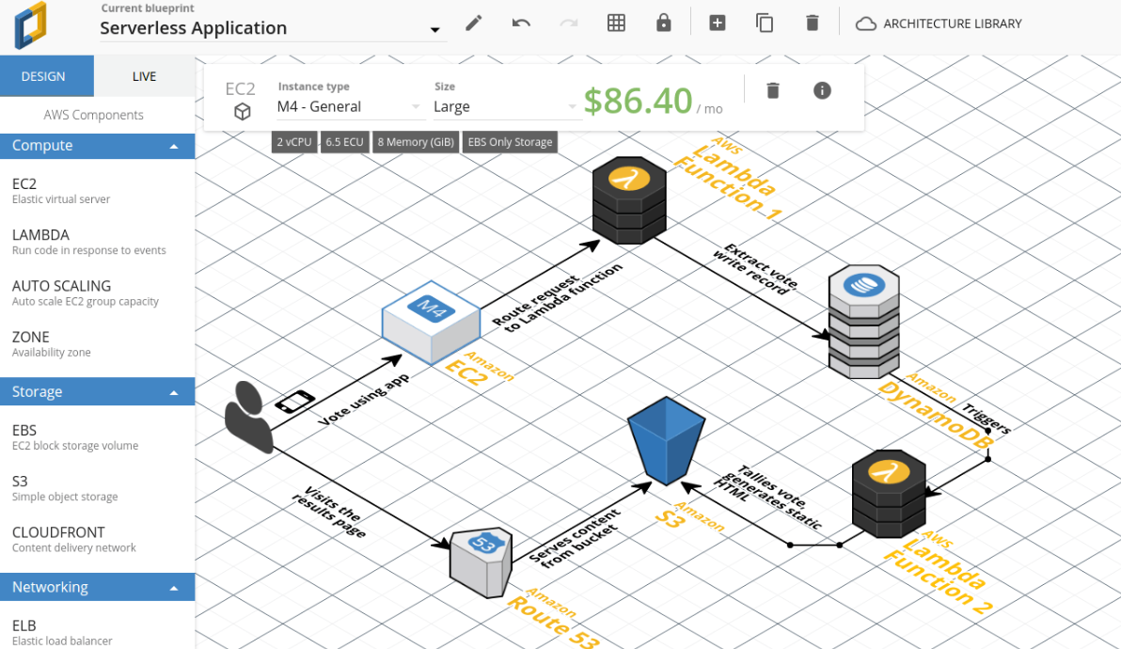
Documentation tools – AWS focus
Cloudcraft
connects to AWS account
can work as a monitor
updates diagrams automatically
can estimate costs
is not a part of AWS

Slide 44
best practices for graphical notations

Slide 45
Best practices for graphical notations
avoid ambiguity
include a key or mention the notation version
in the key, explain whether colors have meaning
use the same style across project documentation

Slide 46
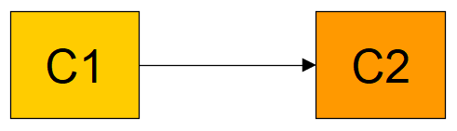
Best practices for graphical notations
avoid ambiguity – bad example
C1 calls C2?
data flows from C1 to C2?
C1 creates C2?
C1 is a subtype of C2?
yellow vs orange?

Slide 47
Best practices for graphical notations
reading direction
ideally, left-to-right and top-to-bottom
or use sink points – distinguishable graph nodes concentrating all edges
or split the diagram (if more than 3-5 sink points)
overlappings
should be avoided at all costs
or join edges going to the same nodes together
or split the diagram
duplication
should be avoided
but may aid dealing with reading direction and overlappings

Slide 48
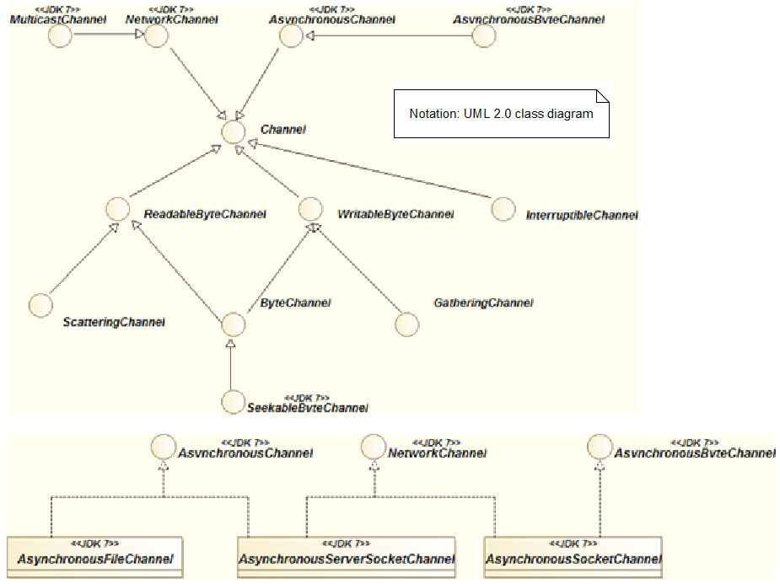
Best practices for graphical notations
example
this is an overview of the JDK NIO package
diagram is split into 2 parts
Channel is a sink point
NetworkChannel is duplicated
the lower part merges inheritance paths leading to the same interfaces

Slide 49
Best practices for graphical notations
color/shape/icon coding
highlight important aspects
speed up perception

Slide 50
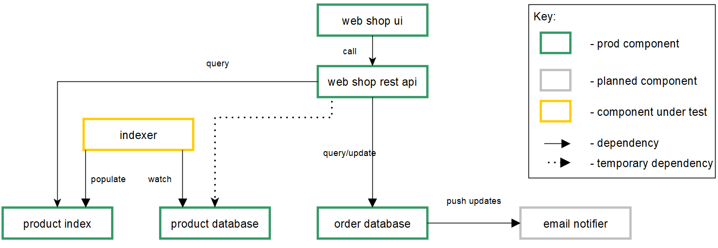
Best practices for graphical notations
example
this is a high-level design of a fictious web shop
colors and line types are used to convey the completeness of the system here

Slide 51
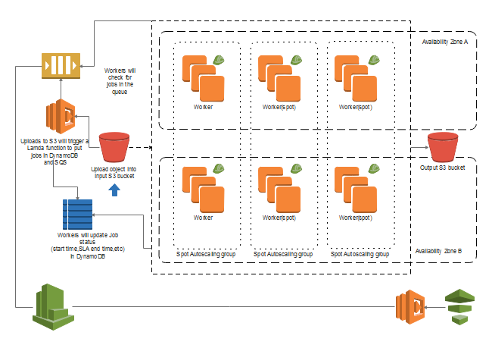
Best practices for graphical notations
example
this is a sample AWS diagram
it benefits from memorizable icons

Slide 52
Best practices for graphical notations
alignment and even spacing
create a feeling of consistency
improve readability

Slide 53
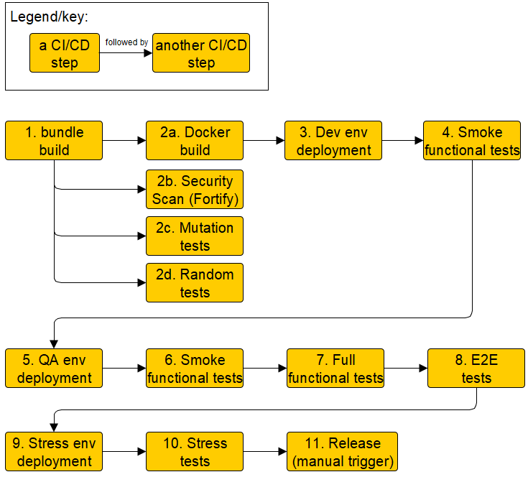
Best practices for graphical notations
example
this is a high-level design of a CI/CD pipeline
even distance between pipeline steps
parallelizable steps are aligned

Slide 54

54

